Slide 1
Hiring Process Analytics
Project-4

Slide 2
Project Description:
The project aims is to analyse the hiring process of a company and provide a report about the analysis made out of the data provided. The analysis has been done using Excel and statistical techniques.
Analysis is done for the following :
A. How many males and females are Hired ?
B. What is the average salary offered in this company ?
C. Draw the class intervals for salary in the company ?
D. Draw Pie Chart / Bar Graph ( or any other graph ) to show proportion of
people working different department ?
E. Represent different post tiers using chart/graph.

Slide 3
Approach :
The datasets which contains tables has the information regarding various fields related to company hiring data. I have gone through the dataset closely and then executed various queries to extract the required data from the table and also made graphs, charts and tables out of the datasets.
Tech Stack Used :
PPT – To prepare a detailed report.
EXCEL – Excel was used to perform entire analysis.

Slide 4
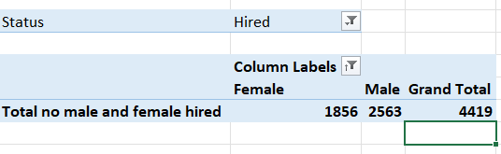
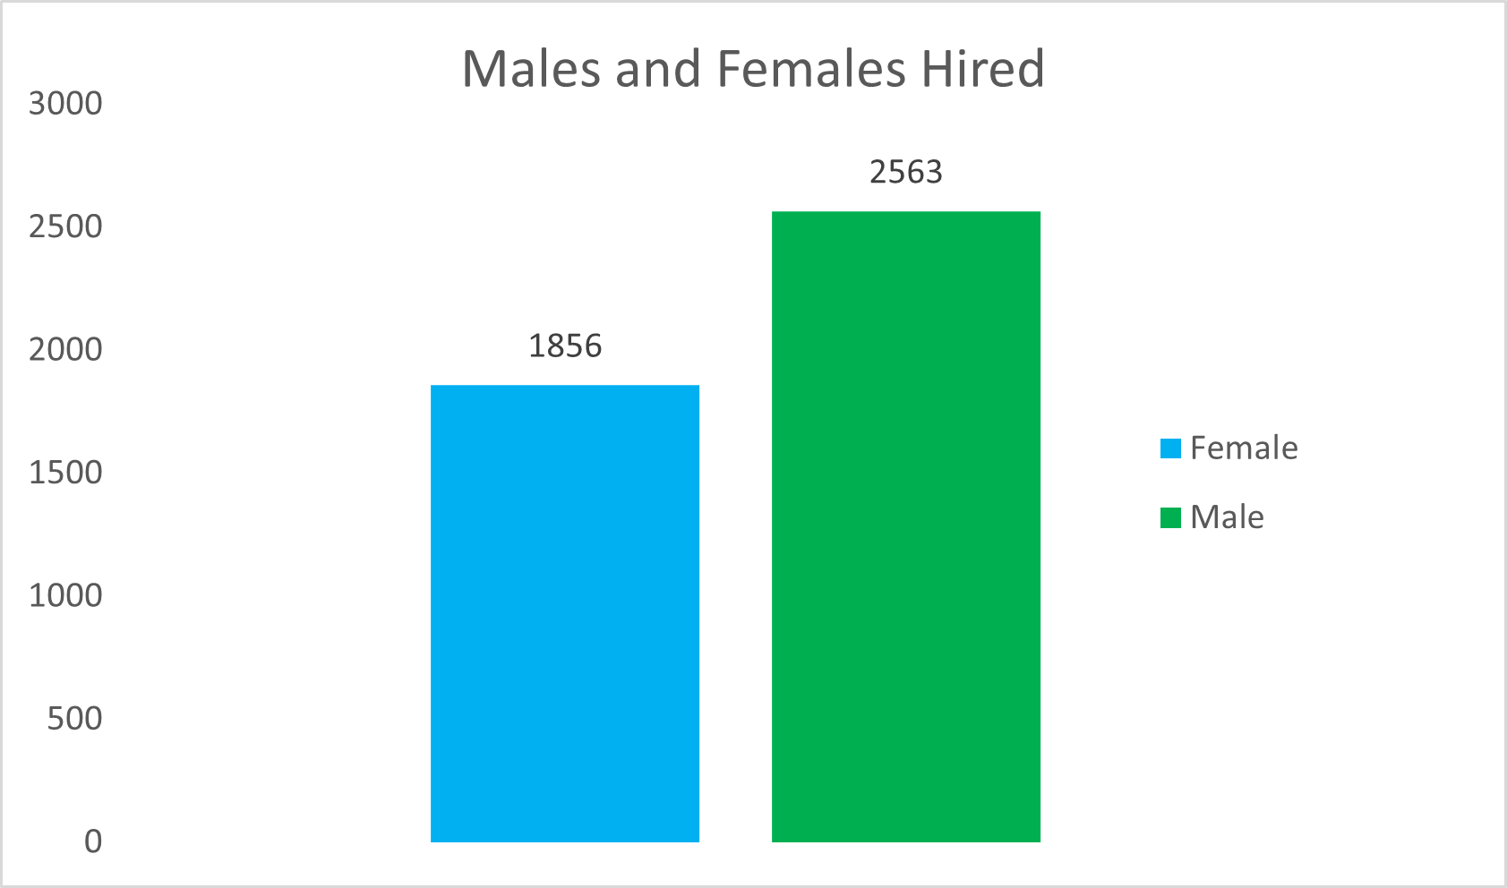
Hiring:
How many males and females are Hired ?

Slide 5
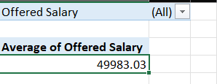
B. Average Salary :
What is the average salary offered in this company ?

Slide 6
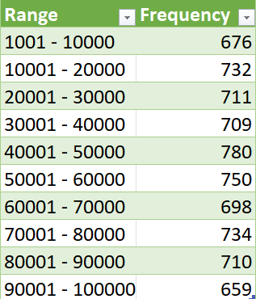
C. Class Intervals :
Draw the class intervals for salary in the company ?

Slide 7
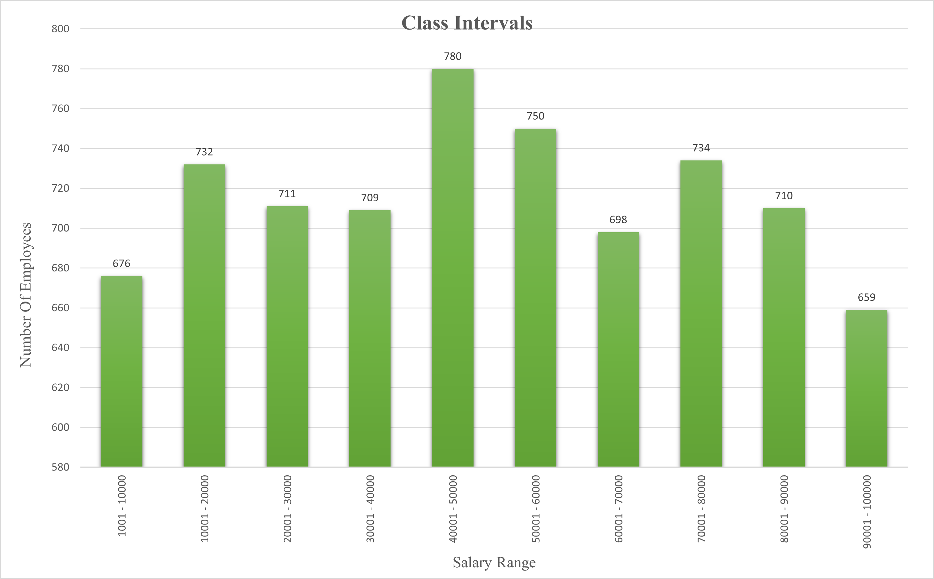

Slide 8
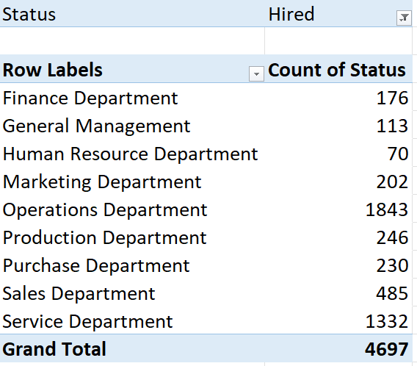
D. Charts and Plots :
Draw Pie Chart / Bar Graph to show proportion of people working different department ?

Slide 9
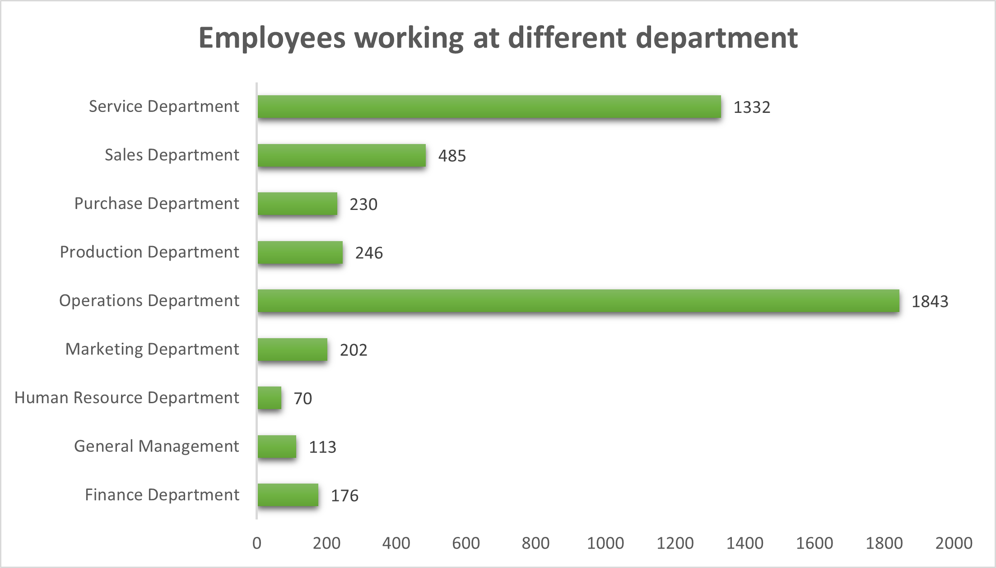

Slide 10
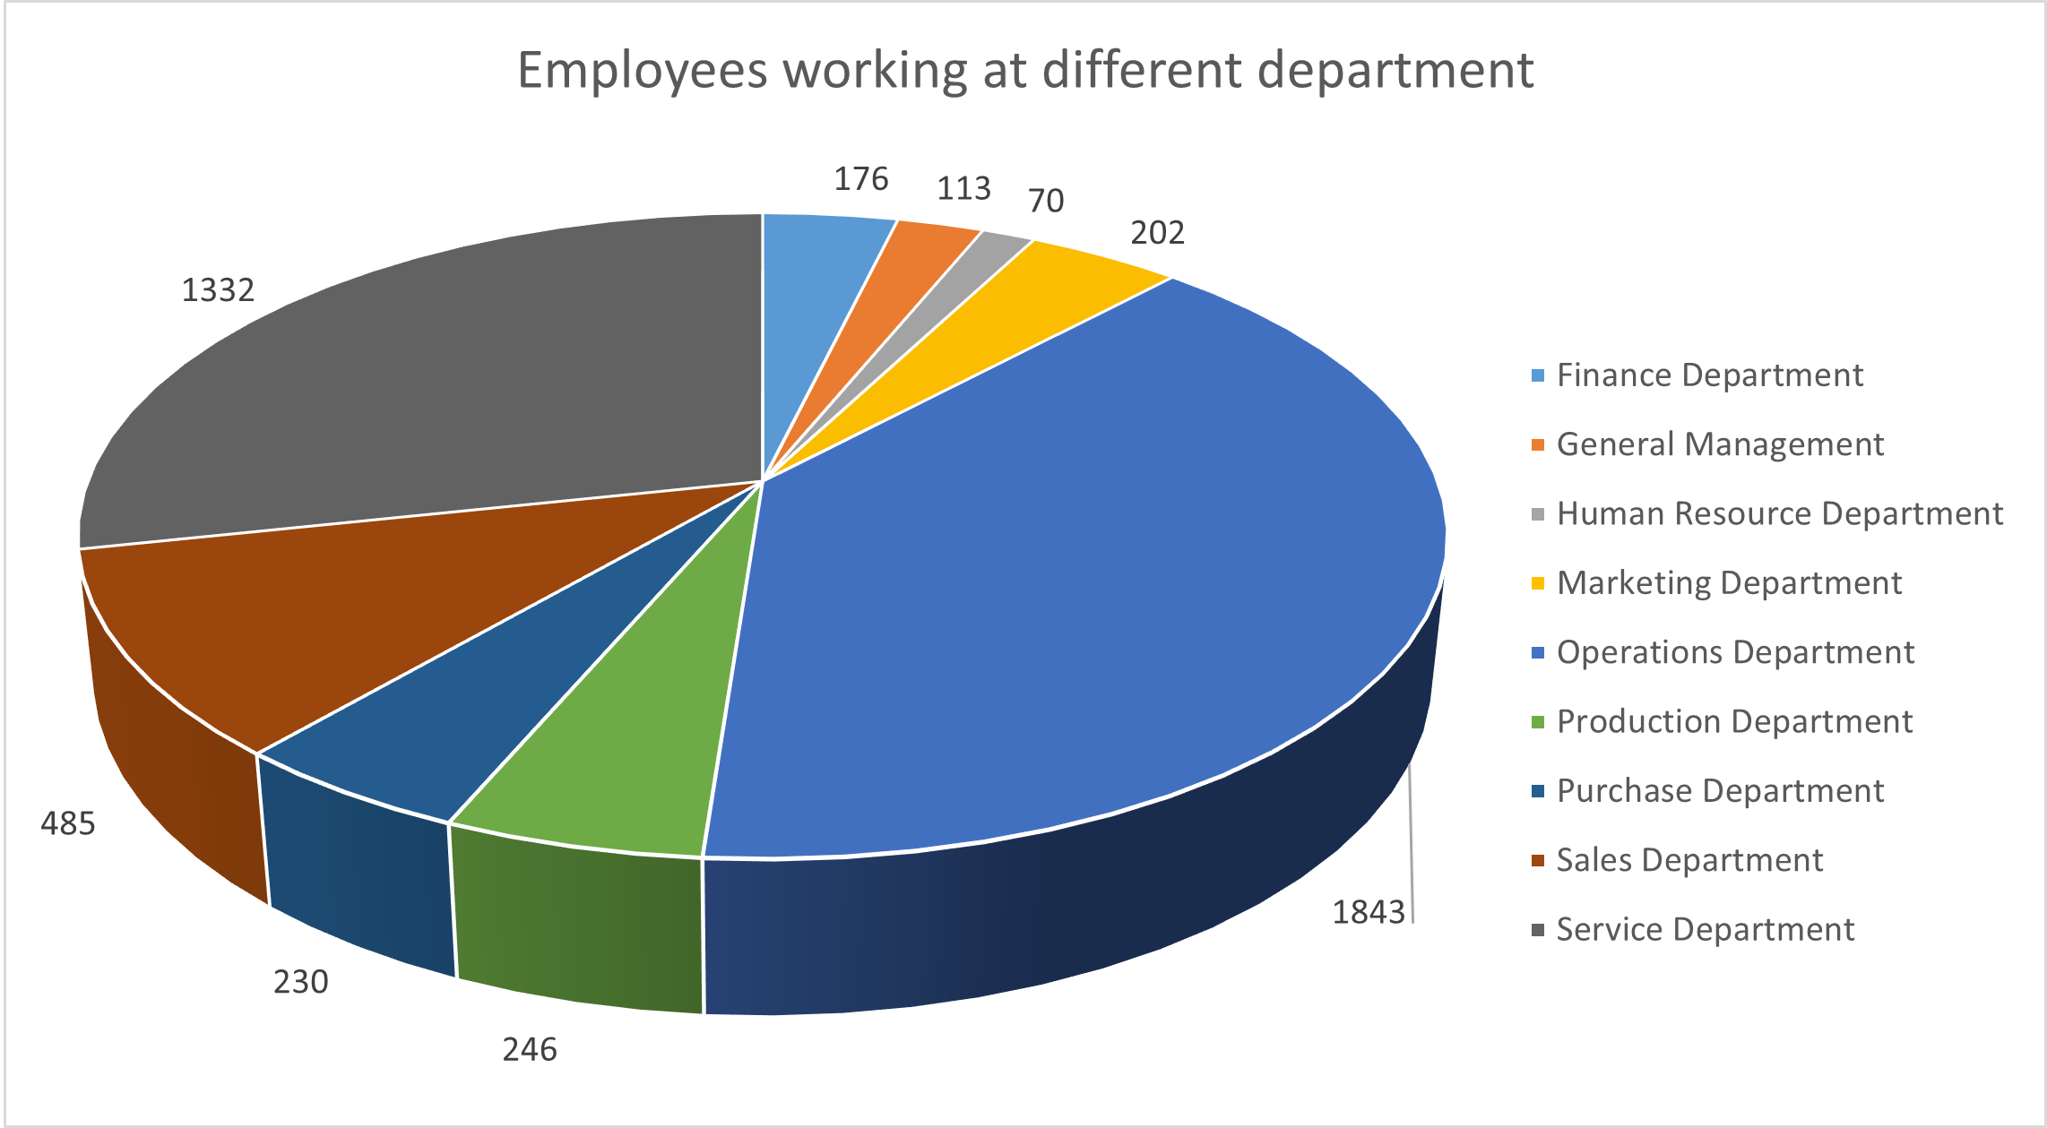

Slide 11
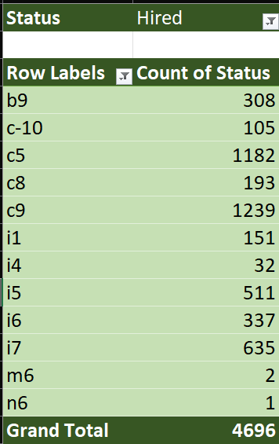
E. Charts:
Represent different post tiers using chart/graph?

Slide 12
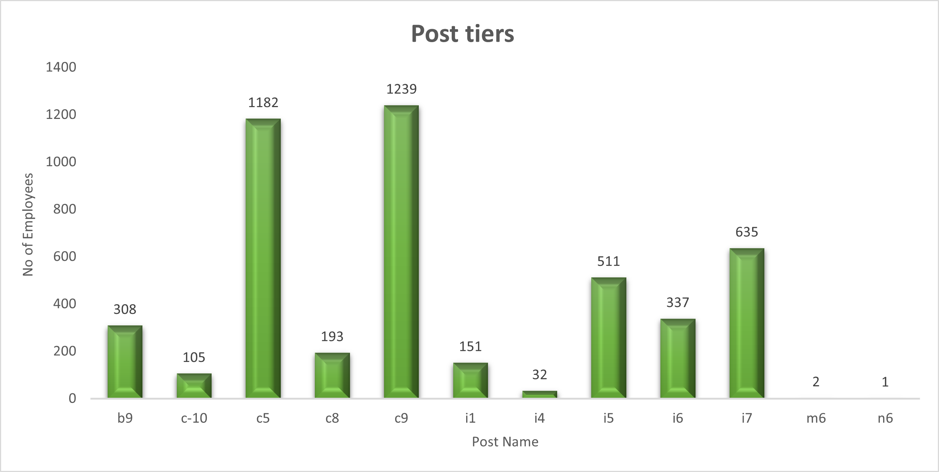

Slide 13
Insights:
Overall, this project provided valuable insights into the hiring process and trends within the company, allowing for improvements to be made to ensure a fair and efficient hiring process.
Result:
I have learned how to manipulate data in MS Excel, along with functions, pivot tables and charts & graphs and also helped me for analyzing and performing EDA in MS Excel.
This project was great learning experience and has helped me to improve my skills and knowledge in data analysis.

